Slide 1
Shapes and Attributes
Notes:
Hi! In this lesson, we’re going to look at how we can add more items to our canvas in order to create more elaborate images. But first, let’s take a look at the color options we have when using Python Graphics.

Slide 2
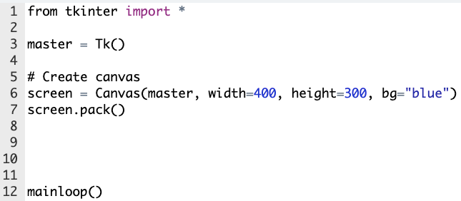

Colors in Python Graphics
from tkinter import *
root = Tk()
# Create canvas
screen = Canvas(root, width=400, height=200, bg="blue")
screen.pack()
mainloop()
Notes:
Right now we’re starting out with a 400x200 canvas with a blue background. We’re simply using the color name ‘blue’, but what if we wanted a lighter blue?

Slide 3

Colors in Python Graphics
from tkinter import *
root = Tk()
# Create canvas
screen = Canvas(root, width=400, height=200, bg="light blue")
screen.pack()
mainloop()
Notes:
Well, one option we have is to use the color name ‘light blue’ instead of ‘blue’. But this still only gives us a minimal number of options for a light blue background.

Slide 4
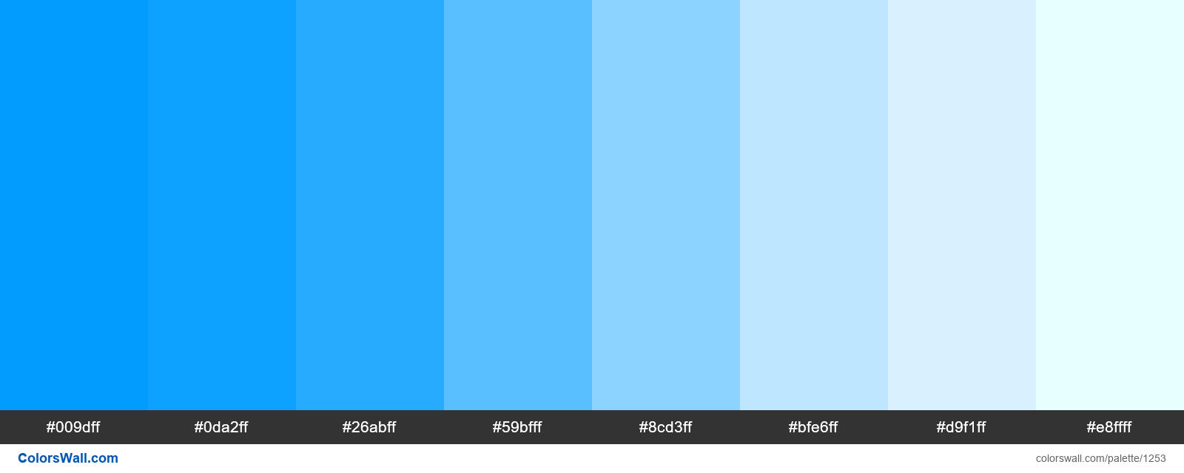
Colors in Python Graphics
Notes:
Another way we can color items in Python graphics is by using the hexcode of a specific color. Hexcodes are created by combining three codes of 2 characters each that tell how much red, blue, and green exists in the color.

Slide 5
Colors in Python Graphics
Notes:
So if we wanted to use this specific shade of blue, we could take the hexcode...

Slide 6
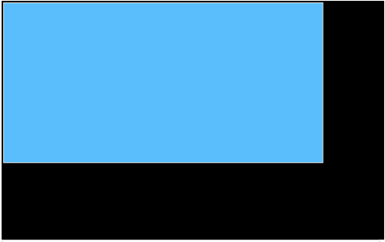
Colors in Python Graphics
from tkinter import *
root = Tk()
# Create canvas
screen = Canvas(root, width=400, height=200, bg="#59bfff")
screen.pack()
mainloop()
Notes:
And enter it into our background attribute inside quotation marks. We just need to remember to include the pound sign at the beginning of the code. Okay, let’s take a look at how to add some new shapes to our canvas.

Slide 7
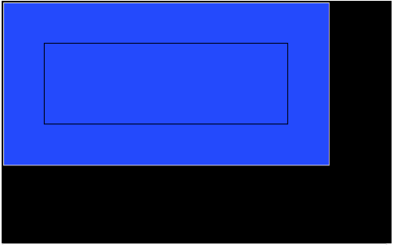
Creating Rectangles
To create a rectangle:
screen.create_rectangle(top left x, top left y, bottom right x, bottom right y)
from tkinter import *
root = Tk()
# Create canvas
screen = Canvas(root, width=400, height=200, bg="blue")
screen.pack()
screen.create_rectangle(50, 50, 350, 150)
mainloop()
Notes:
We can use the command ‘screen.create_rectangle()’ and note the coordinates of the top left corner and bottom right corner of our box to add a rectangle to the screen.

Slide 8
Creating Rectangles
To create a rectangle:
screen.create_rectangle(top left x, top left y, bottom right x, bottom right y)
from tkinter import *
root = Tk()
# Create canvas
screen = Canvas(root, width=400, height=200, bg="blue")
screen.pack()
screen.create_rectangle(50, 50, 350, 150)
mainloop()
(50, 50)
Notes:
Here, the top left corner of our rectangle is located at point 50, 50.

Slide 9
Creating Rectangles
To create a rectangle:
screen.create_rectangle(top left x, top left y, bottom right x, bottom right y)
from tkinter import *
root = Tk()
# Create canvas
screen = Canvas(root, width=400, height=200, bg="blue")
screen.pack()
screen.create_rectangle(50, 50, 350, 150)
mainloop()
(350, 150)
Notes:
And the bottom right corner is located at 350, 150.

Slide 10
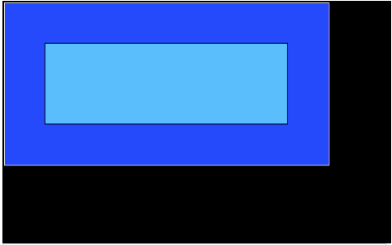
Creating Rectangles
To color rectangle: fill = “color name” or “#hexcode”
from tkinter import *
root = Tk()
# Create canvas
screen = Canvas(root, width=400, height=200, bg="blue")
screen.pack()
screen.create_rectangle(50, 50, 350, 150, fill=“#59bfff”)
mainloop()
Notes:
If we want the rectangle to be colored in, we use the attribute ‘fill’ and note a color name or hexcode.

Slide 11
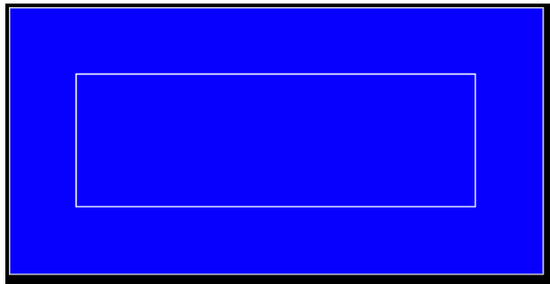
Creating Rectangles
To color rectangle: fill = “color name” or “#hexcode”
To color outline of rectangle: outline = “color name” or “#hexcode”
from tkinter import *
root = Tk()
# Create canvas
screen = Canvas(root, width=400, height=200, bg="blue")
screen.pack()
screen.create_rectangle(50, 50, 350, 150, outline="white")
mainloop()
Notes:
We can also use the attribute ‘outline’ to change the outline color of the shape.

Slide 12
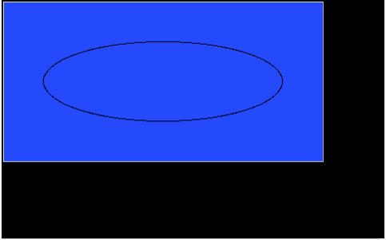
Creating Ovals/ Circles
To create an oval/circle:
screen.create_oval(top left x, top left y, bottom right x, bottom right y)
from tkinter import *
root = Tk()
# Create canvas
screen = Canvas(root, width=400, height=200, bg="blue")
screen.pack()
screen.create_oval(50, 50, 350, 150)
mainloop()
Notes:
If we want to create an oval or circle, we use ‘screen.create_oval()’ and note the top left and bottom right corners of the box surrounding the shape. We can color the oval the same way as a rectangle, using the attributes ‘fill’ and ‘outline’.

Slide 13
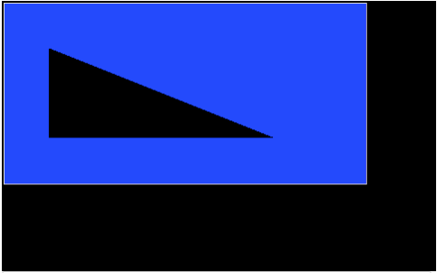
Creating Polygons
To create a polygon:
screen.create_polygon(x1, y1, x2, y2, x3, y3, ...)
from tkinter import *
root = Tk()
# Create canvas
screen = Canvas(root, width=400, height=200, bg="blue")
screen.pack()
screen.create_polygon(50, 50, 350, 150, 50, 150, 50, 50)
mainloop()
Notes:
If we use ‘screen.create_polygon()’, we can see that a filled in shape is drawn when given multiple point locations. It is important to note that a polygon always defaults to being filled in black whereas any shape we draw with the ‘create_line()’ function will just be the outline of the shape.

Slide 14
Attributes Used with Any Shape
Colors shape
fill = “color name” or “color code”
Colors shape outline
outline = “color name” or “color code”
Creates dashed line
dash = number
dash = (number, number)
Controls outline thickness
width = number
Notes:
There are some attributes we can use with any shape we draw.
We’ve already seen the ‘fill’ and ‘outline’ attributes that will color the shape or the outline with a given color but let’s look at some more.
The ‘dash’ attribute will draw a line, or the outline of the shape, with dashes as noted by the numbers given. If one number is given, this will be the distance for each dash and space. If two numbers are given, the first number will be the length of the dash and the second will be the length of the space.
The ‘width’ attribute will control the thickness of the shape’s outline and can be used in conjunction with the ‘outline’ attribute to give a shape a thick, colored border.
Let’s go to our code editor to use these functions and attributes to create some graphics.

Slide 15
Flag of Japan
To create an oval/circle:
screen.create_oval(top left x, top left y, bottom right x, bottom right y)
Constant Values:
canvas_width = 400
canvas_height = 300
circle_radius = 100
Notes:
We’re going to complete this exercise where we’re being asked to draw the Flag of Japan which has a white background with a large red circle in the center. We are given some constant values and before we get to writing our program, let’s take a minute to plan.

Slide 16
Flag of Japan
To create an oval/circle:
screen.create_oval(top left x, top left y, bottom right x, bottom right y)
Constant Values:
canvas_width = 400
canvas_height = 300
circle_radius = 100
Notes:
We know that when we draw a circle or oval, we need to give the coordinates of the top left-hand and bottom right-hand corner of the box surrounding the shape.

Slide 17
Flag of Japan
To create an oval/circle:
screen.create_oval(top left x, top left y, bottom right x, bottom right y)
Constant Values:
canvas_width = 400
canvas_height = 300
circle_radius = 100
Notes:
So we’ll first need to figure out exactly where this point should be located.

Slide 18
Flag of Japan
To create an oval/circle:
screen.create_oval(top left x, top left y, bottom right x, bottom right y)
400 pixels
Constant Values:
canvas_width = 400
canvas_height = 300
circle_radius = 100
Notes:
Well, we know the entire canvas is 400 pixels wide.

Slide 19
Flag of Japan
To create an oval/circle:
screen.create_oval(top left x, top left y, bottom right x, bottom right y)
200 pixels
Constant Values:
canvas_width = 400
canvas_height = 300
circle_radius = 100
Notes:
This means that it is 200 pixels to the center of the circle.

Slide 20
Flag of Japan
To create an oval/circle:
screen.create_oval(top left x, top left y, bottom right x, bottom right y)
200 pixels
100 pixels
Constant Values:
canvas_width = 400
canvas_height = 300
circle_radius = 100
100 pixels
Notes:
If the circle has a radius of 100 pixels, we can subtract this value and find that the x value of this first point should be 100.

Slide 21
Flag of Japan
To create an oval/circle:
screen.create_oval(top left x, top left y, bottom right x, bottom right y)
Constant Values:
canvas_width = 400
canvas_height = 300
circle_radius = 100
300 pixels
Notes:
Now let’s figure out the y position of this point. If the height of the canvas is 300 pixels...

Slide 22
Flag of Japan
To create an oval/circle:
screen.create_oval(top left x, top left y, bottom right x, bottom right y)
150 pixels
Constant Values:
canvas_width = 400
canvas_height = 300
circle_radius = 100
Notes:
Then it would be 150 pixels to the center of the circle.

Slide 23
Flag of Japan
To create an oval/circle:
screen.create_oval(top left x, top left y, bottom right x, bottom right y)
150 pixels
Constant Values:
canvas_width = 400
canvas_height = 300
circle_radius = 100
100 pixels
Notes:
And if the circle has a radius of 100 pixels...

Slide 24
Flag of Japan
To create an oval/circle:
screen.create_oval(top left x, top left y, bottom right x, bottom right y)
50 pixels
150 pixels
Constant Values:
canvas_width = 400
canvas_height = 300
circle_radius = 100
100 pixels
Notes:
...we can subtract these values to get a y value of 50 pixels.

Slide 25
Flag of Japan
To create an oval/circle:
screen.create_oval(top left x, top left y, bottom right x, bottom right y)
(100, 50)
Constant Values:
canvas_width = 400
canvas_height = 300
circle_radius = 100
Notes:
To get the coordinates of the second point, we would follow a similar process.

Slide 26
Flag of Japan
To create an oval/circle:
screen.create_oval(top left x, top left y, bottom right x, bottom right y)
200 pixels
Constant Values:
canvas_width = 400
canvas_height = 300
circle_radius = 100
100 pixels
300 pixels
Notes:
We would add the 200 pixels to get to the center of the canvas to 100 pixels which is the radius of the circle to get an x coordinate of 300.

Slide 27
Flag of Japan
To create an oval/circle:
screen.create_oval(top left x, top left y, bottom right x, bottom right y)
150 pixels
Constant Values:
canvas_width = 400
canvas_height = 300
circle_radius = 100
250 pixels
100 pixels
Notes:
And for the y value, we could add the 150 pixels from the top of the canvas to the center of the circle to the 100 pixels from the circle’s radius and get a y coordinate of 250.

Slide 28
Flag of Japan
To create an oval/circle:
screen.create_oval(top left x, top left y, bottom right x, bottom right y)
(100, 50)
Constant Values:
canvas_width = 400
canvas_height = 300
circle_radius = 100
(300, 250)
Notes:
Now that we have all the info we need, let’s go write this in the editor.

Slide 29
Commands learned this lesson
Command | What does it do?
screen = Canvas(root, width=number, height=number) | Creates a canvas with the given dimensions
screen.create_rectangle(top left x, top left y, bottom right x, bottom right y) | Creates a rectangle
screen.create_oval(top left x, top left y, bottom right x, bottom right y) | Creates an oval/circle
screen.create_line(x1, y1, x2, y2) | Creates a line

Slide 30
Commands learned this lesson
Command | What does it do?
screen.create_line(x1, y1, x2, y2, x3, y3, ...) | Creates a line to all given points
screen.create_polygon(x1, y1, x2, y2, x3, y3, ...) | Creates a polygon
dash = number or dash = (number, number) | Creates a dashed line or outline
fill = “color name” or “#hexcode” | Colors in a shape
outline = “color name” or “#hexcode” | Colors the outline of shape
width = number | Controls thickness of outline/line

